Slide 1


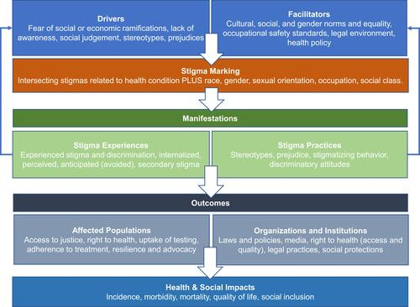
Examining the Correlation Between Substance Use Disorder During Pregnancy and Socioeconomic Disparities in Maternal Mortality and Morbidity
Sade Graves; Advisor: Aize Cao, PhD
Department of Biomedical Data Science, School of Applied Computational Sciences, Meharry Medical College, Nashville, TN
Introduction
Material
Conclusion
Materials
Addressing substance use disorders (SUD) in pregnancy is an urgent public health concern, as it leads to severe risks such as sepsis, eclampsia, heart attacks, heart failure, and death. The most common substances associated with substance-exposed pregnancy (SEP) are alcohol, tobacco, cannabis, opioids, cocaine, and prescription medications.
The identification of socioeconomic disparities and social determinants among substance use disorder pregnancies is crucial, as it significantly impacts prenatal care, SUD treatments, and postpartum maternal health.
Socioeconomic disparities, such as insurance coverage, income status, race, and age, serve as significant barriers to accessing quality care for pregnant women with SUD.
The most significant social determinant of health in the healthcare system for pregnant women who use substances is stigmatization, which is an instrumental factor leading to health inequities and inadequate healthcare treatment. These socioeconomic and social determinants underscore the need for more equitable healthcare systems to ensure all women receive help.
In my research, I conducted a literature review using a keyword search strategy to find eighteen relevant studies and literature on the socioeconomic disparities and social determinants of health as they relate to substance use disorders(SUD).
I searched academic and public health databases, including PubMed, NIH, and Google Scholar, to access peer-reviewed and statistical analysis articles.
Given the significant impact of socioeconomic disparities and determinants on pregnant women with SUD, it is crucial to evaluate the healthcare access, healthcare process, treatments, and recovery resources available to them during the prenatal and postpartum periods.
This research aims to address a critical gap in our understanding of the impact of socioeconomic disparities and stigma determinants on pregnant women with SUD.
By examining this issue, we can better understand these women's challenges and work towards improving their healthcare access and quality.
Proposed Methods
A health survey questionnaire will be conducted to gather information from female volunteers in the southeast area of Memphis, Tennessee.
Data will be collected from credit publications and various sources datasets.
References
Ragsdale, A. S., Al-Hammadi, N., Bass, S., & Chavan, N. R. (2024). Racial and Ethnic Disparities Among Pregnancies with Substance Use Disorder: Impact on Perinatal Outcomes. Journal of Women's Health.
Weber, A., Miskle, B., Lynch, A., Arndt, S., & Acion, L. (2021). Substance use in pregnancy: identifying stigma and improving care. Substance Abuse and Rehabilitation, 105-121.
Glover, C. F. (2023). Exploring the Social Determinants of Health Among Pregnant Women with Substance Use Disorder: An In-depth Analysis of the Drug Free Moms and Babies Project.
Nidey, N., Kair, L. R., Wilder, C., Froehlich, T. E., Weber, S., Folger, A., ... & Bowers, K. (2022). Substance use and utilization of prenatal and postpartum care. Journal of addiction medicine, 16(1), 84-92.
Objectives
Results
Increase awareness and understanding of the impacts of specific socioeconomic disparities and social determinants, such as income level, race, maternal age and insurance status, on the lack of access and quality care to healthcare, on substance use disorder in pregnant women, and their maternal health.
Uncovering relevant information on healthcare access, treatment, and addiction recovery that has led to positive health outcomes for maternal women with substance use disorders offers hope for improved maternal health.
To investigate the impact of socioeconomic disparities, specifically insurance and income status, on pregnant women with a substance use disorder.
To evaluate the healthcare access, healthcare process, treatments, and recovery resources for Substance use disorder pregnant women during the prenatal and postpartum periods.
To shed light on social determinants of health factors that hinder care for Substance use disorder pregnant women
To Provide knowledge on how to identify and socioeconomic disparities of a Substance use disorder in pregnant women to supply positive quality healthcare.
Acknowledgments
The Morgan State University Maternal Health Equity Coordinating Center Summer Research Internship Program supports this work. We also want to thank Dr. Arif Mahmud and Dr. Aize Cao for their support throughout the project
Figure 1. The Health Stigma and Discrimination Framework (Weber et al.)

